Slide 1

Big Data Analytics with Cloud, Fog and Edge Computing
First Author: S.Bhavadharani
Second Author: Chavakula Nagasrimayi
Third Author: Muchharla Naga Keshava
Forth Author: Uppu Naveen Kumar
College: Saveetha School of Engineering

Slide 2
ABSTRACT
IoT's Ubiquity: Integral to modern life, enabling efficiency and connectivity in various domains.
Cloud Computing's Evolution: From infrastructure reduction to global-scale service provision by major players like IBM and Amazon.
Service Categorization: IaaS for remote infrastructure, PaaS for development, and SaaS for business applications.
Enhanced IoT Capabilities: Cloud integration facilitates data storage, analysis, and real-time insights for businesses.
Future Outlook: Continued integration of IoT with cloud computing, with advancements in Edge and Fog Computing driving optimization.

Slide 3
INTRODUCTION
Cloud Computing Essentials: Cloud computing enables access to applications and customization online, utilizing network or internet services.
Service Classification: Cloud services are categorized into public or private networks, further divided into WAN, LAN, or VPN, offering storage, infrastructure, and application resources.
Deployment and Service Models: Cloud providers offer models such as SaaS, PaaS, and IaaS, catering to diverse user needs and preferences.
Integration with IoT: Cloud enhances IoT capabilities by providing centralized storage, real-time data processing, and analytics.
Transition to Edge Computing: Edge computing addresses latency issues by processing data locally, especially crucial for IoT applications.

Slide 4
Challenges and Solutions: Cloud faces challenges like security, talent gap, and data management, with ongoing efforts to address these issues.
Real-Life Applications: Cloud, Fog, and Edge computing find applications in disaster recovery, smart systems, and healthcare, improving efficiency and scalability.
Analytics Importance: Cloud analytics provides benefits like improved decision-making, planning, and agility, essential for business success.
Tools for Implementation: Various tools like Cloud Sim, Skytree, and Spark facilitate implementation and analysis of big data in cloud environments.
Future Opportunities Emerging technologies like AI, ML, and Blockchain offer promising avenues for further research and innovation in cloud, fog, and edge computing.

Slide 5
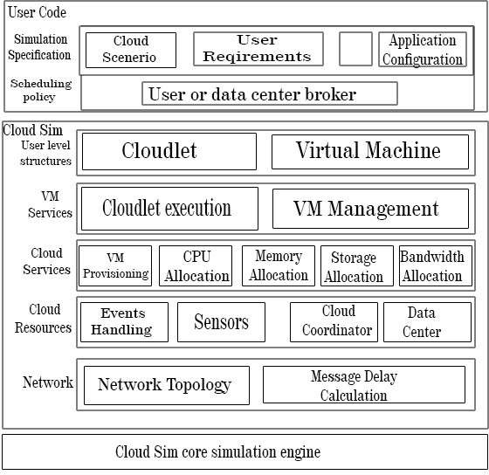
ARCHITECTURE

Slide 6
Opportunities for Future
Cost Reduction and Revenue Enhancement: Both cloud and fog computing aim to boost revenue by minimizing costs through efficient resource utilization.
Enhanced Security: Evolving technologies like cloud, fog, and edge computing bring about reliable and improved security measures, crucial for safeguarding data.
Remote Data Storage: Shift towards remote data storage over physical locations offers scalability and accessibility.
Cyber-Physical Systems (CPS): Interconnection of IoT devices forms the backbone of cyber-physical infrastructure, enabling various applications.

Slide 7
Research Opportunities: Emerging challenges in IoT and big data integration call for focused attention from research communities.
Integration of Cloud, Fog, and Edge Computing: Combination of these technologies addresses real-time problems across diverse applications.
Importance of Fog Computing: Fog computing aids in efficient decision-making by analyzing historical operational data, reducing bandwidth usage, and enhancing infrastructure performance.

Slide 8
Future Research Directions:
Exploration of artificial intelligence in cloud computing.
Integration of AI into edge computing.
Leveraging AI and blockchain for IoT-based cloud applications.
Adoption of machine learning for automated analytics.
Collaborative Efforts: Researchers and scientists are encouraged to focus on resolving critical issues and gaps identified in the field.

Slide 9
_{SUMMARY}
Cloud computing, once prominent, has now been overshadowed by fog and edge computing due to evolving user demands.
Together, these technologies can revolutionize IT and real-world applications, providing efficient services to citizens.
Integration of big data analytics and IoT enables proactive healthcare measures, such as sending alerts to doctors and providing patient access to information.
Blockchain technology emerges as a vital tool for data protection in open networks, ensuring security and privacy.
Future endeavors should focus on integrating big data analytics, IoT devices, cloud computing, and blockchain technology to address emerging challenges and innovate for better services.

Slide 10
_{REFERENCES}
Keiko Hashizume, David G Rosado, Eduardo Fernández-Medina,Eduardo B Fernandez, “An analysis of security issues for cloud computing”, Journal of Internet Services and Applications, December 2013.
Pedro Caldeira Neves, Bradley Schmerl, Jorge Bernardino, “Big Data in Cloud Computing: features and issues”
Dolui, K. and Datta, S. K. (2017). Comparison of Edge Computing Implementations: Fog Computing, Cloudlet and Mobile Edge Computing. 2017 Global Internet of Things Summit (GIoTS), Geneva, 2017, pp. 1-6.
Dolui, K. and Datta, S. K. (2017). Comparison of Edge Computing Implementations: Fog Computing, Cloudlet and Mobile Edge Computing. 2017 Global Internet of Things Summit (GIoTS), Geneva, 2017, pp. 1-6.
A Survey on the Edge Computing for the Internet of Things Wei Yu, Fan Liang, Xiaofei He, William

Slide 11
THANK
YOU

